Slide 1
Solving the Elf Game
Github.com/tmerrittsmith/elf_game

Slide 2
Finite-horizon Markov Decision Processes with Expected Total Reward Objective

Slide 3
How I spent a year trying to ruin a children’s game

Slide 4
Solving the Elf Game

Slide 5
What we might get out of this evening:
How to model something
Some nifty python tricks… and all the things I could have done better
A bit of maths
SOLVING THE ELF GAME!!!

Slide 6
The game:
Players run a business where they make money by sending elves out to cut down christmas trees and sell them.
The winner is the player with the most money at the end of 10 turns.
There are three possible locations to send elves:
Woods ($10 per tree)
Forest ($20)
Mountain ($50).
Risks are associated with different tree locations, depending on the weather.
If the weather is bad (where p(bad weather) = 1/3):
Elves in the forest return empty handed Elves on the mountain get lost and never return.
Each turn, players can hire more elves ($75 each)
Players start with 12 elves, and $0

Slide 7
Play the elf game
github.com/tmerrittsmith/elf-game
Run the cells up to human_elf_game()

Slide 8
Where is the win button?

Slide 9
Bots
Automate the game to try out some different strategies
Used **kwargs to play different bots against each other

Slide 10
**Kwargs
Dictionary of keyword arguments
def multibot_elf_game(total_days,**kwargs):
day_count = 0
tracker = {}
bot_start = {'funds':0,'elf_count':12,'profit_tracker':[],'elf_count_tracker':[]}
for bot in kwargs:
## a dictionary to keep track of each bot's progress
tracker[kwargs[bot].__name__]=deepcopy(bot_start)
.__name__ returns the name of the function, so that we know who is who

Slide 11
Solving the elf game part 1
Trying to optimise a bot:
Run it loads of times, varying one parameter
Figure out the best tuning
Win

Slide 12
Solving the elf game part 1
Trying to optimise a bot:
Run it loads of times, varying one parameter
Figure out the best tuning
Win
Improvements:
Tidy up multibot_elf_game: I should have used classes, right?
Get some graphs to show how awesome your bot is
Come up with a clever way of optimising:
Genetic Algorithms?
Montecarlo Simulations?

Slide 13
Solving the Elf Game part 2: The Email
It is indeed possible to model your problem as a so-called: "finite-horizon MDP with expected total reward objective" One can then, in principle, solve such a model to find the optimal policy by using a "backward induction" dynamic programming algorithm.

Slide 14
Solving the Elf Game part 2: The Email
I can give more details, but at some point this will amount to writing out all the details of the dynamic programming algorithm for you.

Slide 15
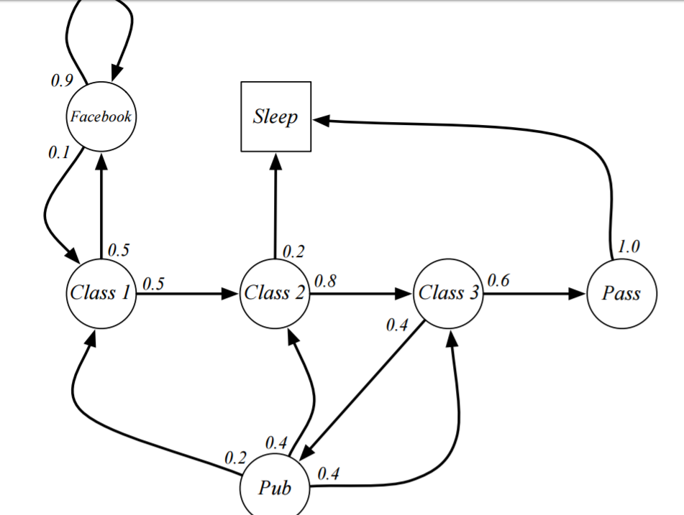
Finite-Horizon Markov Decision Processes
Markov Decision Process – “The Future is Independent of the Past, given the present”
Given a state S, move to state S’ with probability P(S’|S)
Finite-Horizon – because there’s a limited number of days, a limit on the number of elves

Slide 16
Backward Induction
“I will not explain this algorithm in detail here (it is described more generally in the lecture notes for my algorithmic game theory course), but the basic idea is that one starts at the "leaves" of the game tree (i.e., at the terminal states in this MDP), and by induction going back up the tree, one makes an optimal choice for (a,b,c) at that state, depending on the already computed optimal expected payoffs that have been calculated for all of its "children" (i.e., states in the "next" round).”

Slide 17
Backward Induction
e.g. the game 21 (or Nim)
Instead of thinking from the beginning, go to the end of the game and work backwards.

Slide 18
Memoisation
e.g. Triangle Numbers 1 + 2 + 3 + 4 + …
#Write a recursive function that returns the sum of the first n integers.
def triangle_sum(n):
if n == 1:
return 1
else:
return n + triangle_sum(n-1)
This can be done with a recursive function, but it’s SLOOOOWWW…
So, use memoisation – store each intermediate result to speed up the overall calculation

Slide 19
Memoisation
e.g. Triangle Numbers 1 + 2 + 3 + 4 + …
memo = {1:1}
def triangle_sumM(n):
if n in memo.keys():
return memo[n]
else:
memo[n]=n+triangle_sumM(n-1)
return memo[n]

Slide 20
Memoisation
def memoize(f):
cache = {}
def decorated_function(*args):
if args in cache:
return cache[args]
else:
cache[args] = f(*args)
return cache[args]
return decorated_function
@memoize

Slide 21
My woeful attempt!
Rewrite Elfgame with matrix multiplication
Expected rewards transition matrix
Recursive_tree(state):
If the state isn’t in the lookup table:
Generate each new layer of the tree
Once at the bottom of the tree, store the best result, then work back up to find the intermediate steps

Slide 22
[ 0 3 75 0]
1
[0 4 0 1]
[0 4 0]
[ 1 4 53 0]
0
[ 1 4 53 1]
[0 1 3]
[ 2 3 166 0]
0
[ 2 3 166 1]
[0 0 3]
[ 3 2 266 0]
0
[ 3 2 266 1]
[0 0 2]
[ 4 1 332 0]
End
So far, it runs ok for
4 days, 3 elves, $75

Slide 23
My woeful attempt!
Rewrite Elfgame with matrix multiplication
Expected rewards transition matrix
Recursive_tree(state):
If the state isn’t in the lookup table:
Generate each new layer of the tree
Once at the bottom of the tree, store the best result, then work back up to find the intermediate steps
What you could do:
Try out the memorisation examples
Make Recursive_tree work
Tell me why Recursive_tree won’t work (the space is too big?)
Go back to making awesome bots

